Slide 1
TTC DELAYED BUS
ANALYSIS
Supervised By: Prof. Graham Wall

Slide 2
TEAM MEMBERS – GROUP 4
— C0886857
— C0885064
— C0886910
— C0886861
— C0884854
Bahauddin Kalyani
Dev Makwana
Trushna Patel
Krina Patel
Mahaveersinh Chauhan

Slide 3
ABOUT TTC
Established
in 1921 1
4 modes of transportation 2
It has 191 Bus routes in Toronto with 8556 Bus stops 3
Km of bus routes – 6486.9km 4

Slide 4
PROBLEM STATEMENT
The TTC wants to take action to maintain smooth bus service throughout the winter after receiving complaints from passengers about the growing delays in the bus service.
The TTC has access to a lot of data and seeks to identify the main problems before developing a potential course of action.

Slide 5
DATASET SOURCE
DATA
LICENCE
TYPE
PUBLISHED BY
ABOUT
CONTACT
TTC Bus Delay Data (2014-2022) - data
Open Government Licence - Toronto - link
Excel
Toronto Transit Commission
This dataset provides us information about Toronto TTC bus delay over a period of time through many features.
opendata@ttc.ca

Slide 6
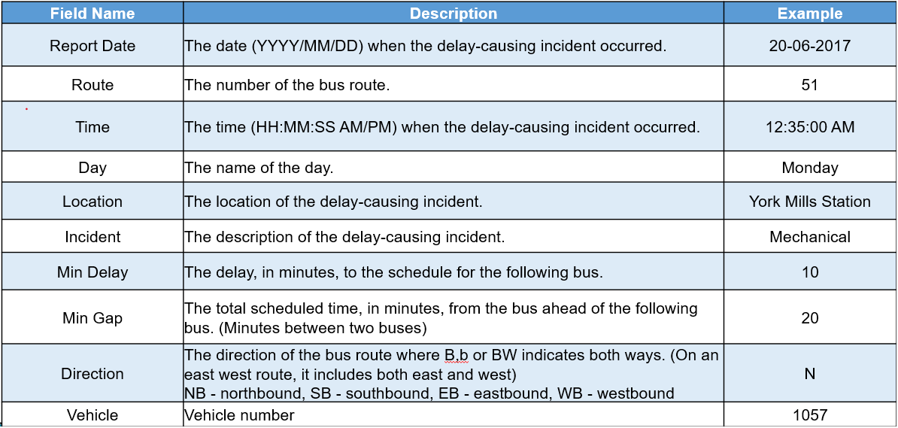
DATASET FEATURES

Slide 7
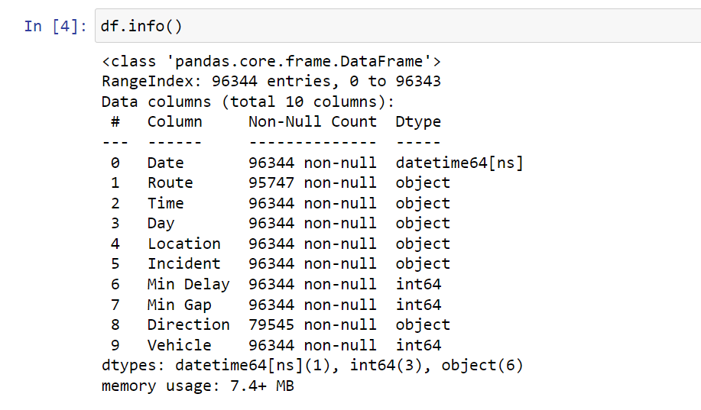
Data Info

Slide 8
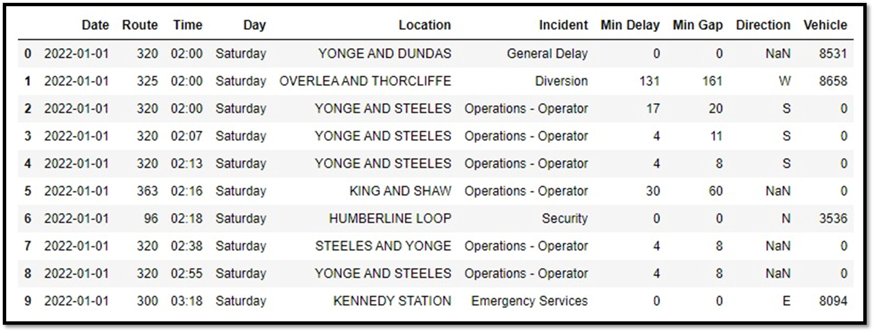
DATASET DETAILS

Slide 9
EXPLORATORY DATA
ANALYSIS

Slide 10
DATA VALIDATION AND CLEANING
01
02
03
Finding & Removing Null Values
Data Cleaning
Filtering
Columns
Significant invalid, and missing entries in the Route and Direction columns were eliminated
Character entries from Route column were converted to integers
Vehicle column has been dropped as it has only unique values

Slide 11
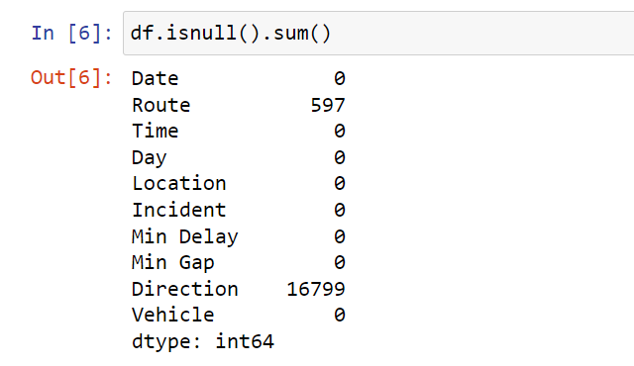
Count of Null values

Slide 12
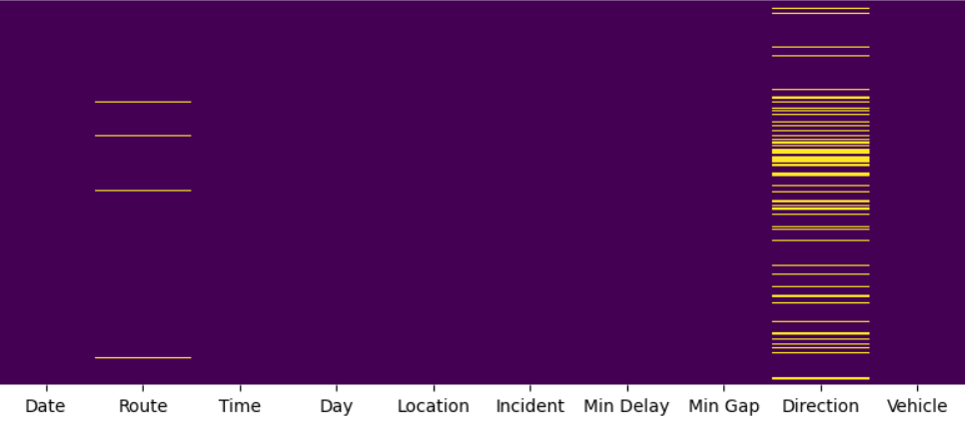
HEATMAP FOR NULL VALUES
It is observed that Route and Direction columns has null values.

Slide 13
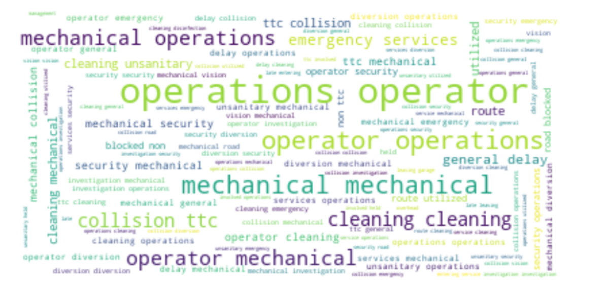
Word Cloud of Incidents

Slide 14
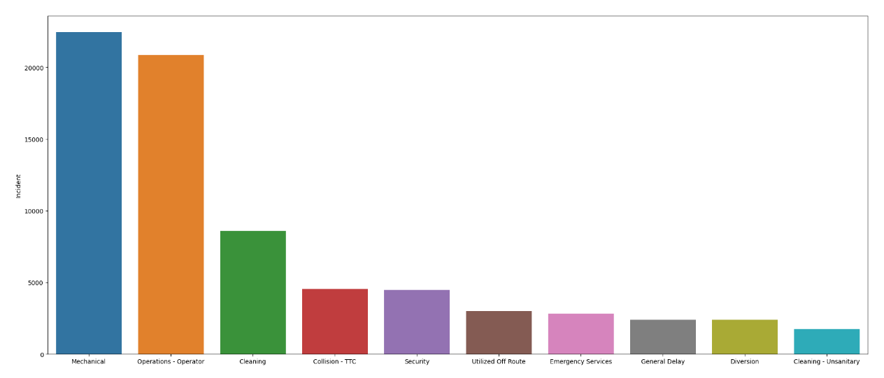
VISUALIZING INCIDENTS WITH MAXIMUM DELAYS
It is observed that most number of delays occurs due to Mechanical or Operator incidents.

Slide 15
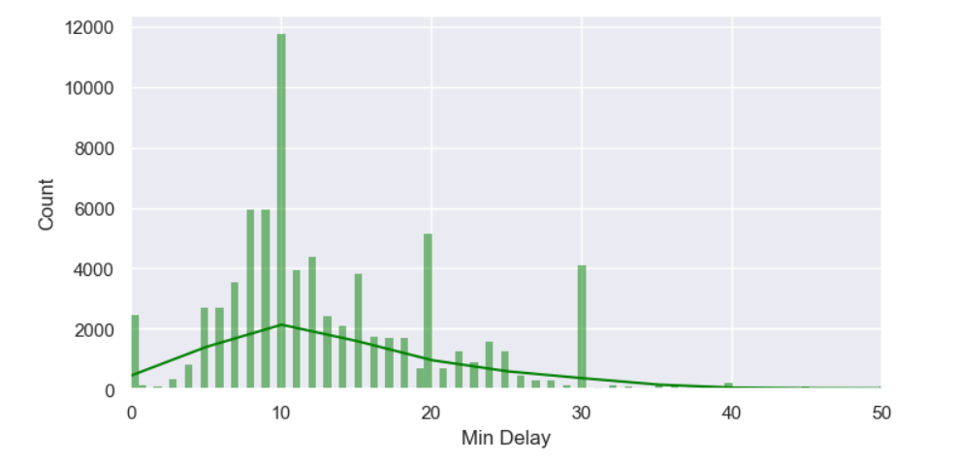
OCCURENCE OF MINUTE DELAYS
Delay in minutes ranges between 5 to 20 mins.

Slide 16
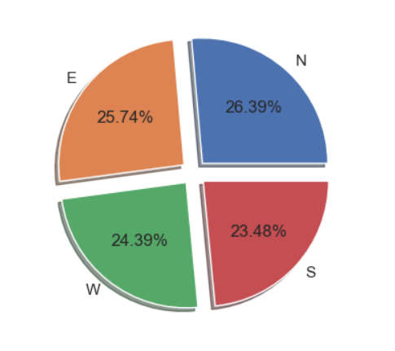
VISUALIZING OCCURRENCE OF DIRECTION WITH DELAY
Delays occurred in all directions, but they did not have a significant impact on the overall delays.

Slide 17
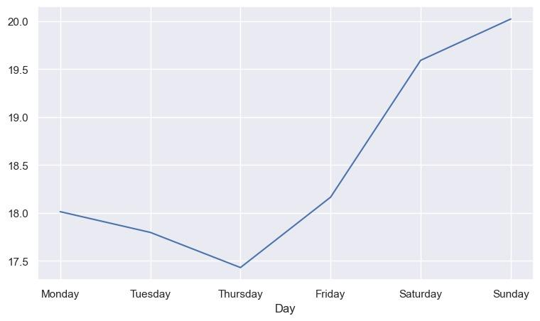
DELAYS ACCORDING TO DAYS OF THE WEEK
It has been observed that delays frequently happen on weekends.

Slide 18
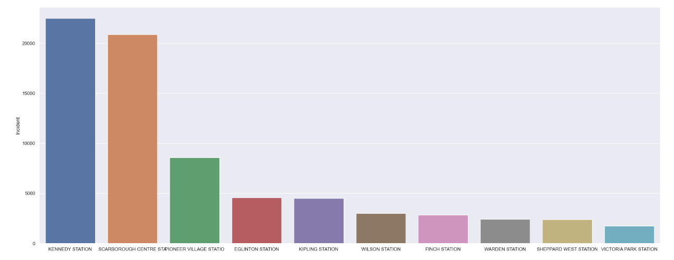
ANALYZING LOCATIONS WITH MAXIMUM DELAYS
Maximum delay occurs at Kennedy and Scarborough center stations with more than 20000 bus delays.

Slide 19
FEATURE
ENGINEERING

Slide 20
FEATURE ENCODING
Convert categorical values into numerical ones.
Day, Location, Incident and Direction columns need to be converted into a numeric label.
We have used LabelEncoder to transform the data into numerical format.

Slide 21
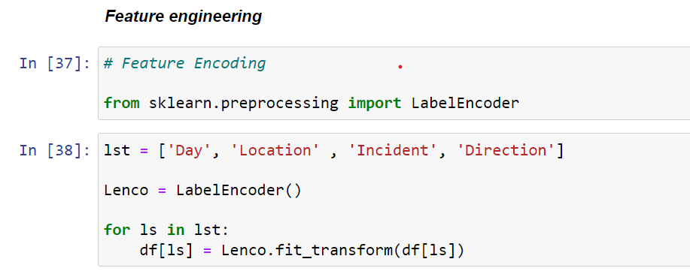

Slide 22
FEATURE EXTRACTION
Extract feature from the existing data.
TTC Dataset has date and time column so we need to split the Day, Month and Time for further delay prediction.

Slide 23
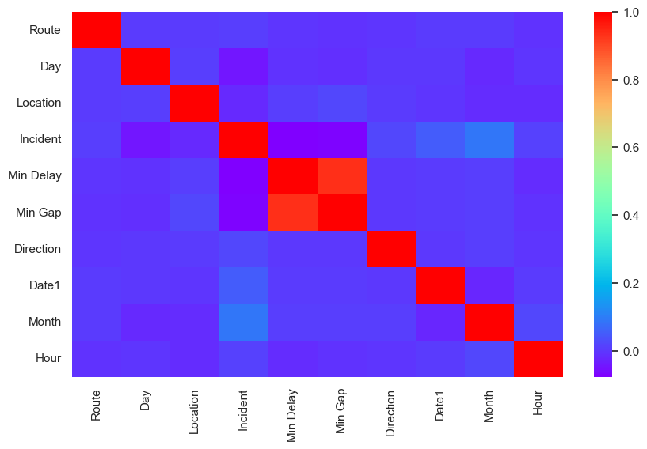
CORRELATION MATRIX

Slide 24
FEATURE SCALING
Feature scaling is required to normalize the range of independent variable or features of the data.
We have applied the “MinMaxScaler” algorithm for feature scaling.

Slide 25
FEATURE SELECTION
The process of reducing the number of input variables when developing a predictive model.
According to the SelectKBest algorithm with chi2 score function, Min Gap, Route and Location are highly related to the Min Delay.

Slide 26
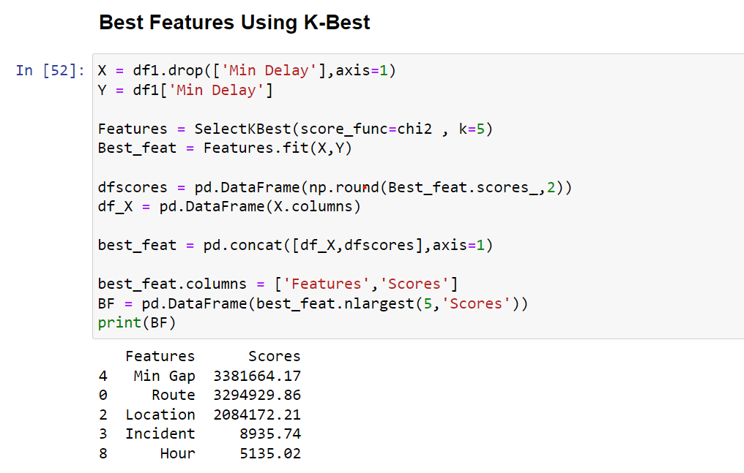
Finding Best Features

Slide 27
TRAINING AND TESTING SPLIT
We have train_test_split function to split the data between training dataset and testing dataset.
We have split random 80 percent of the data into training set and remaining 20 percent of the data into testing set.
80%
Training
20%
Testing

Slide 28
MODEL
TRAINING

Slide 29
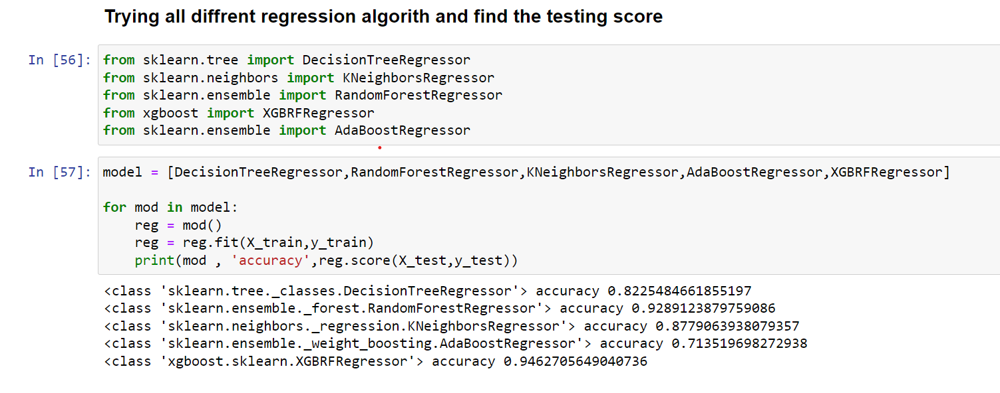
Trying Different Models

Slide 30
REGRESSION ALGORITHMS
Algorithm | Accuracy (In percentage)
Decision Tree Regressor | 85.23 %
Random Forest Regressor | 94.02 %
K Neighbours Regressor | 87.71 %
AdaBoostRegressor | 72.95 %
XGBoost Regressor | 94.95 %

Slide 31
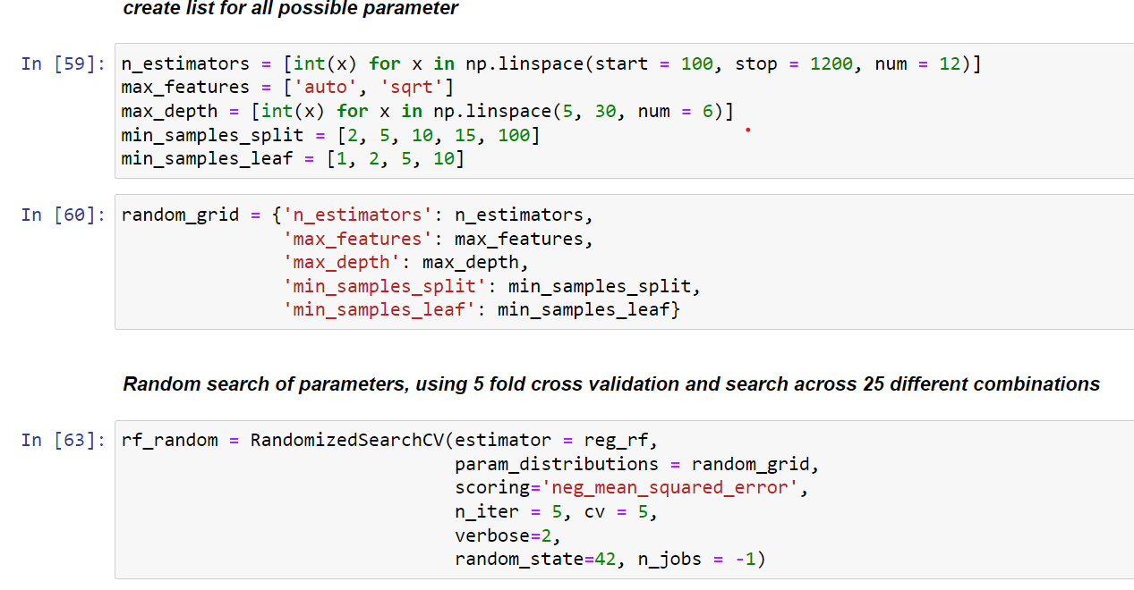
Randomized Search CV

Slide 32
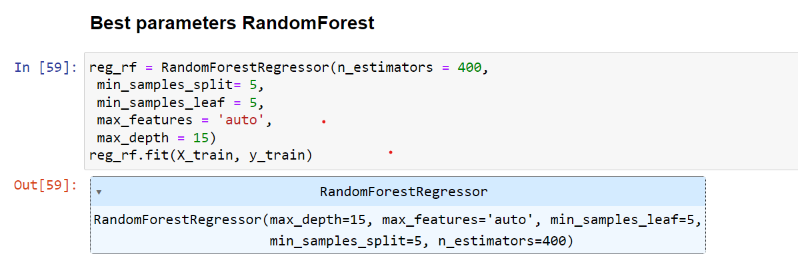
Best Parameters Random Forest

Slide 33
REGRESSION ALGORITHMS
According to the previous table, Random Forest Regressor algorithm and XGBoost gives best output.
However, Random Forest Regressor is robust to outliers, it was used as the baseline algorithm for further processing.
But for the best accuracy we need to hyper tuning the parameter.
“RandomizedSearchCV” algorithm is used for getting optimal parameters of the function.
After applying the optimal parameters, Random Forest Regressor algorithm gives 95.49 percent accuracy.

Slide 34
RESULT

Slide 35
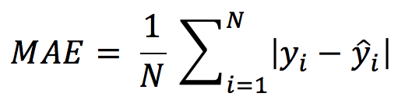
MEAN ABSOLUTE ERROR
The mean absolute error is the average difference between the observations (true value) and model output (predictions). 5
Formula for MAE 6
Where, N = Total Number of Data points
Y_i = True Value
Ŷ_i = Predicted Value
Mean Absolute Error for after hyper-parameter tuning is 1.35.

Slide 36
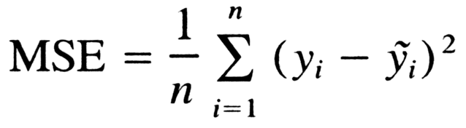
MEAN SQUARED ERROR
The mean squared error is the average squared difference between the observations (true value) and model output (predictions). 7
Formula for MSE 8
Where, N = Total Number of Data points
Y_i = True Value
Ŷ_i = Predicted Value
Mean Squared Error was observed to be 48.28.

Slide 37
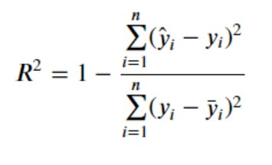
R-SQUARED SCORE
R-Squared is a statistical measure that indicates the percentage of the variance in the dependent variable that the independent variables explain collectively. 9
Formula for R-Square score 10
Where, Ȳ = Mean Value
Y_i = True Value
Ŷ_i = Predicted Value
Lastly, the obtained R-squared score was 0.95.

Slide 38
SHAPASH MODEL EXPLAINER
Shapash is a Python library which aims to make machine learning interpretable and understandable by everyone. It provides several types of visualization that display explicit labels that everyone can understand.
Shapash works for Regression, Binary Classification or Multiclass problem.

Slide 39
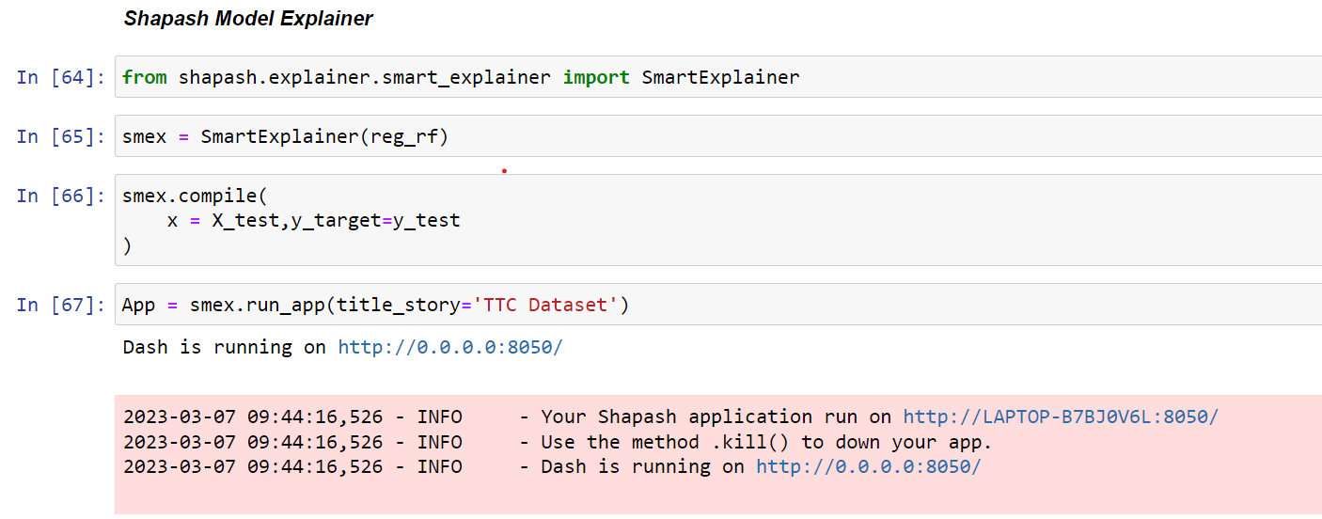
Shapash Model

Slide 40
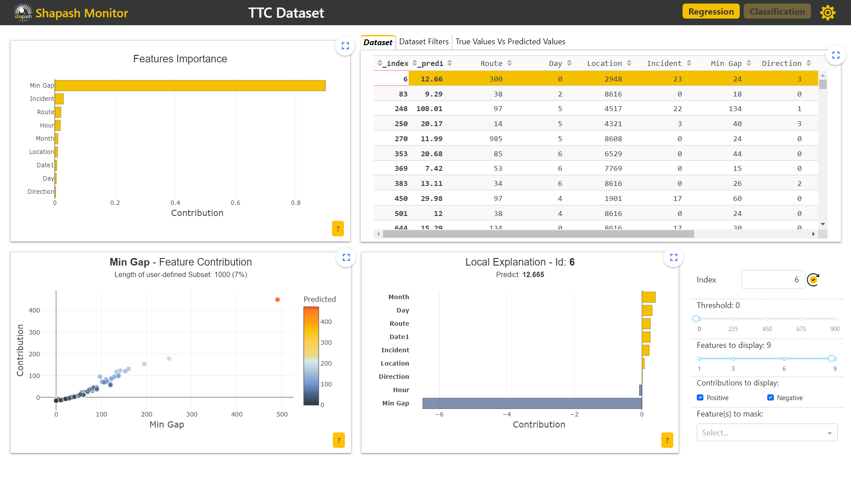
Web App View

Slide 41
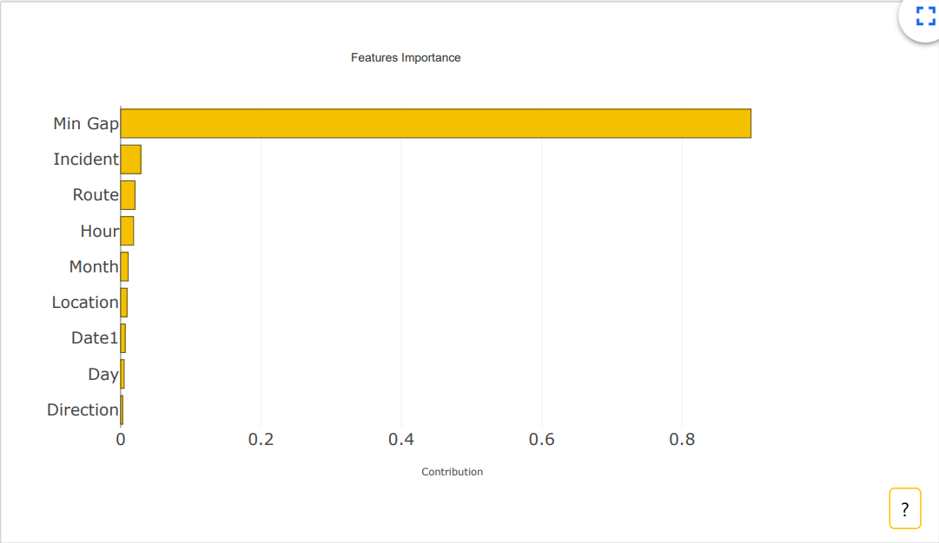
SHAPASH MODEL EXPLAINER

Slide 42
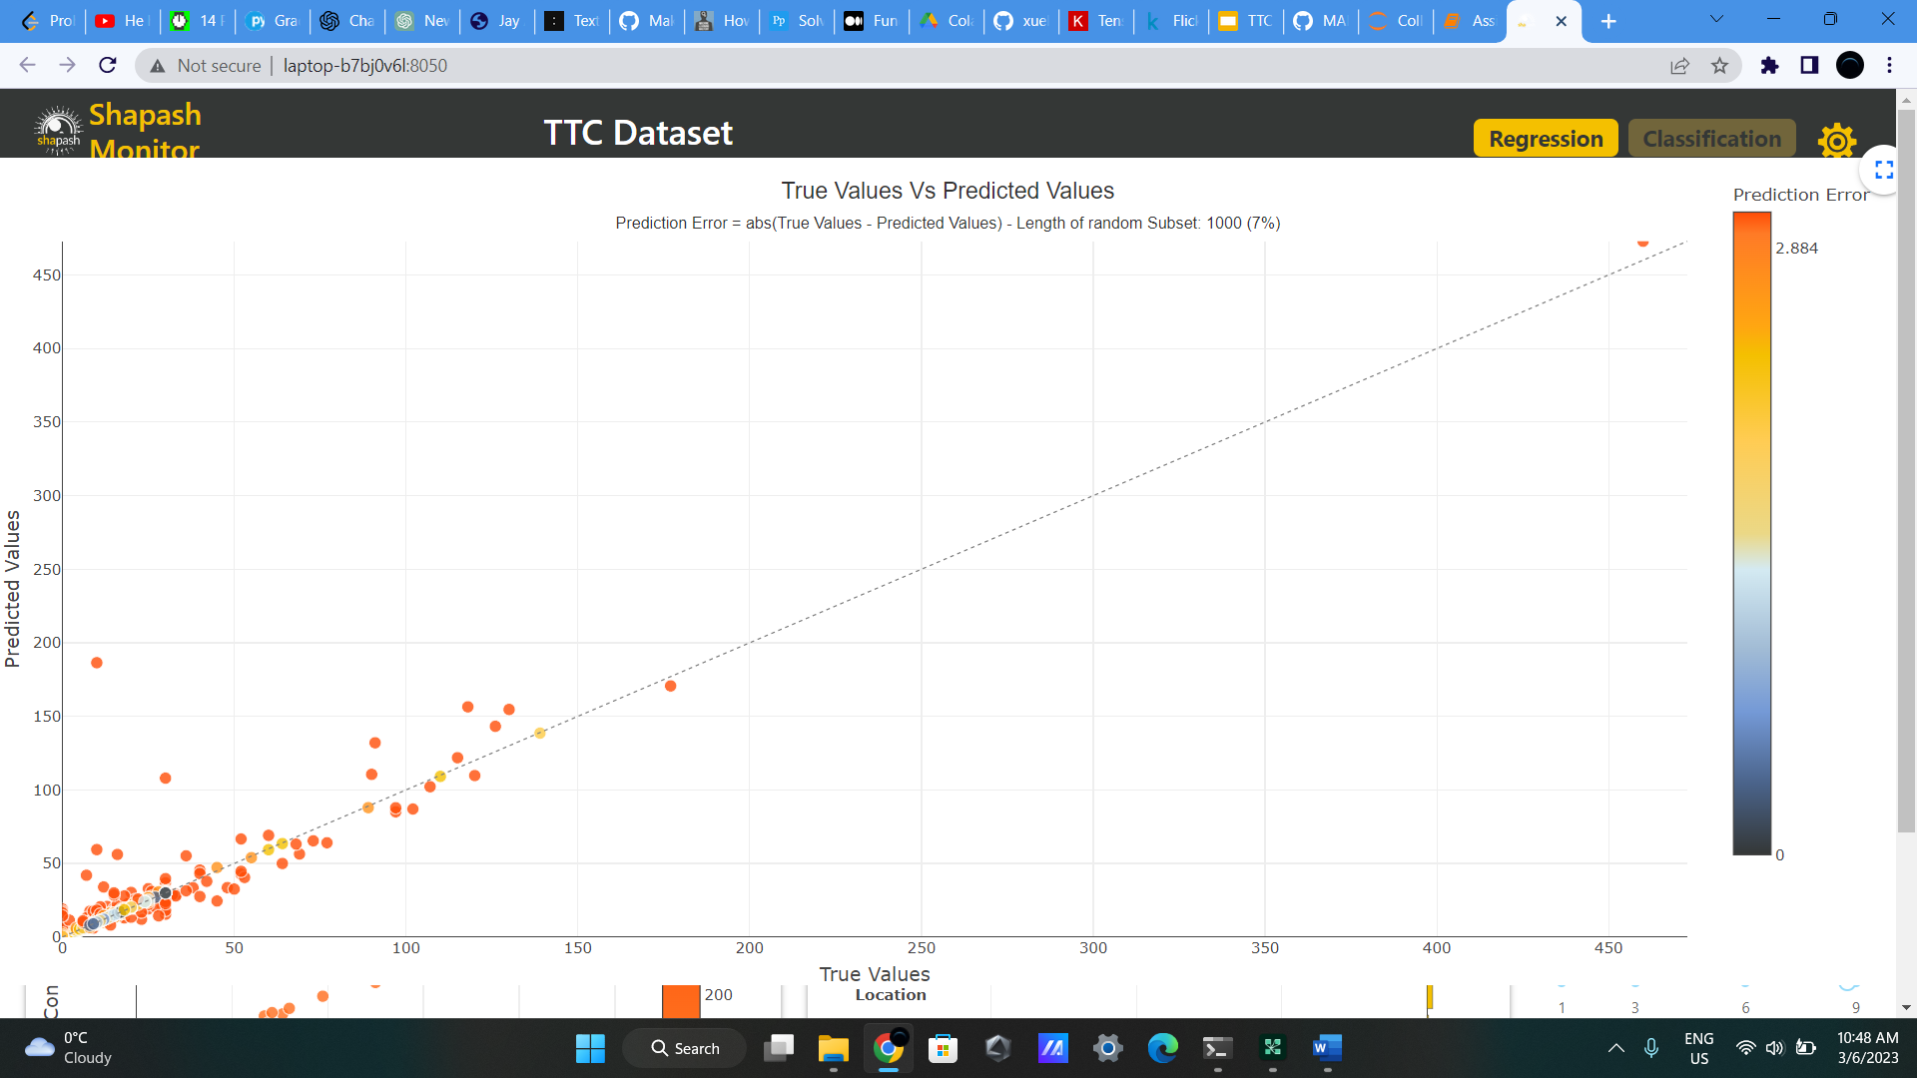
SHAPASH MODEL EXPLAINER

Slide 43
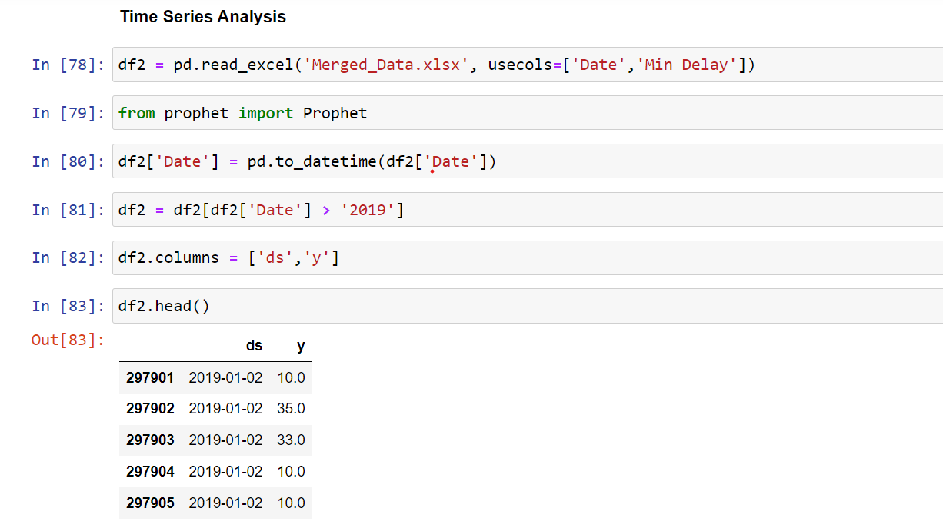
FB Prophet

Slide 44
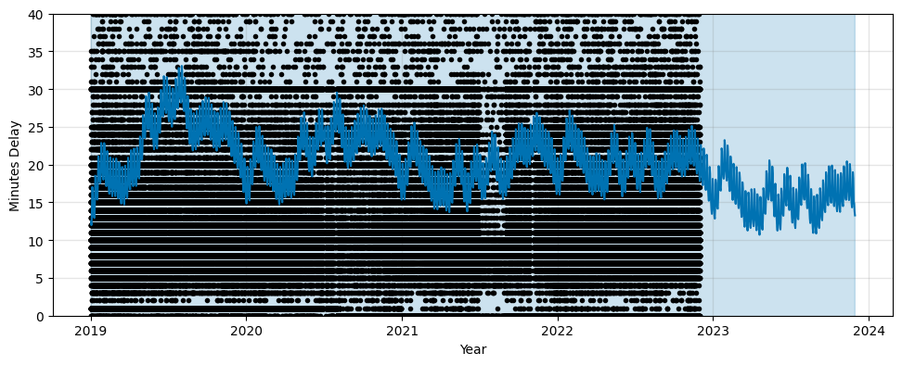
TIME SERIES ANALYSIS

Slide 45
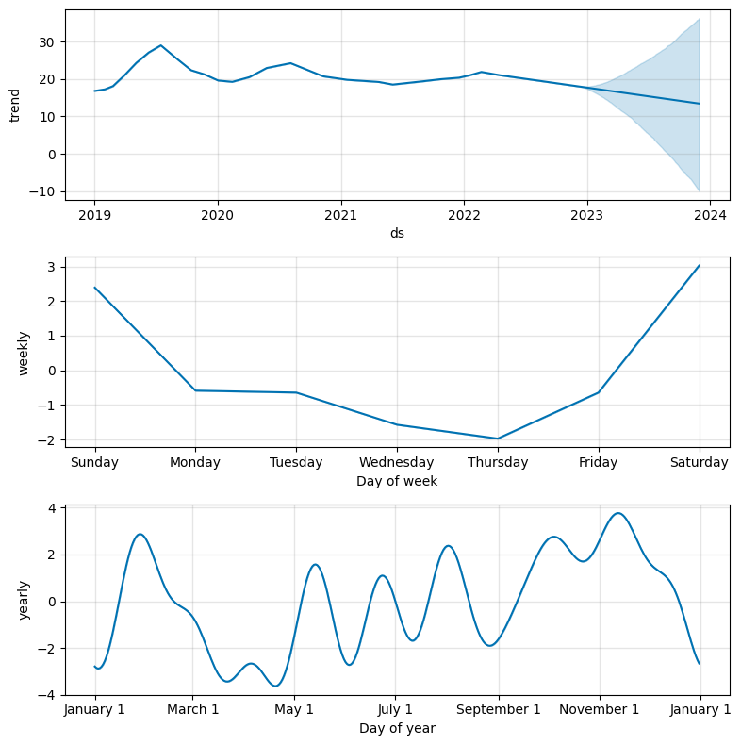
TIME SERIES ANALYSIS

Slide 46
CONCLUSION
Questions based on gaps, delays, and incidents that caused a delay in previous data can be answered using the findings and insights from the dataset analysis. Also, these findings can be used to forecast the amount of delay that will occur daily, weekly, and annually in 2023 to assess the potential impact of incidents in specific regions.

Slide 47
REFERENCES
Background image: Abstract pixel rain blue background from https://www.freepik.com/free-vector/abstract-pixel-rain-blue-background_6070946.htm/?utm_source=slidesgo_template&utm_medium=referral-link&utm_campaign=sg_resources&utm_content=freepik
Data - Open Data Dataset. (n.d.). Retrieved January 23, 2023, from https://open.toronto.ca/dataset/ttc-bus-delay-data/
Wikipedia. (n.d.). Toronto Transit Commission. Wikipedia. Retrieved January 23, 2023, from https://en.wikipedia.org/wiki/Toronto_Transit_Commission
Toronto Transit Commission. (2021). 2021 Operations Statistics. ttc.ca. Retrieved January 23, 2023, from https://www.ttc.ca/transparency-and-accountability/Operating-Statistics/Operating-Statistics---2021/Conventional-System
TTC, Toronto – bus Times, Routes & Updates. (n.d.). Moovit. Retrieved January 23, 2023, from https://moovitapp.com/index/en/public_transit-lines-Toronto_ON-143-434
Toronto Transit Commission. (2022). 2021 Operating Statistics. ttc.ca. Retrieved January 23, 2023, from https://www.ttc.ca/transparency-and-accountability/Operating-Statistics/Operating-Statistics---2021/Conventional-System
What is Mean Absolute Error. (n.d.). Deepchecks. Retrieved March 5, 2023, from https://deepchecks.com/glossary/mean-absolute-error/

Slide 48
REFERENCES
6. Frost, J. (2017, April 16). How To Interpret R-squared in Regression Analysis. Statistics By Jim. http://statisticsbyjim.com/regression/interpret-r-squared-regression/
7. Frost, J. (2021, November 12). Mean Squared Error (MSE). Statistics By Jim. https://statisticsbyjim.com/regression/mean-squared-error-mse/
8. Kumar, A. (2022, February 21). R-squared, R2 in Linear Regression: Concepts, Examples. Data Analytics. https://vitalflux.com/r-squared-explained-machine-learning/
9. Machine learning: An introduction to mean squared error and regression lines. (2018, October 16). FreeCodeCamp.Org. https://www.freecodecamp.org/news/machine-learning-mean-squared-error-regression-line-c7dde9a26b93/
10. Stephanie. (2016, October 25). Absolute Error & Mean Absolute Error (MAE). Statistics How To. https://www.statisticshowto.com/absolute-error/

Slide 49
THANKS
Do you have any questions?
Please keep this slide for attribution

